Slide 1




DIGITAL LITERACY
SKILLS
BASIC USERS

Slide 2
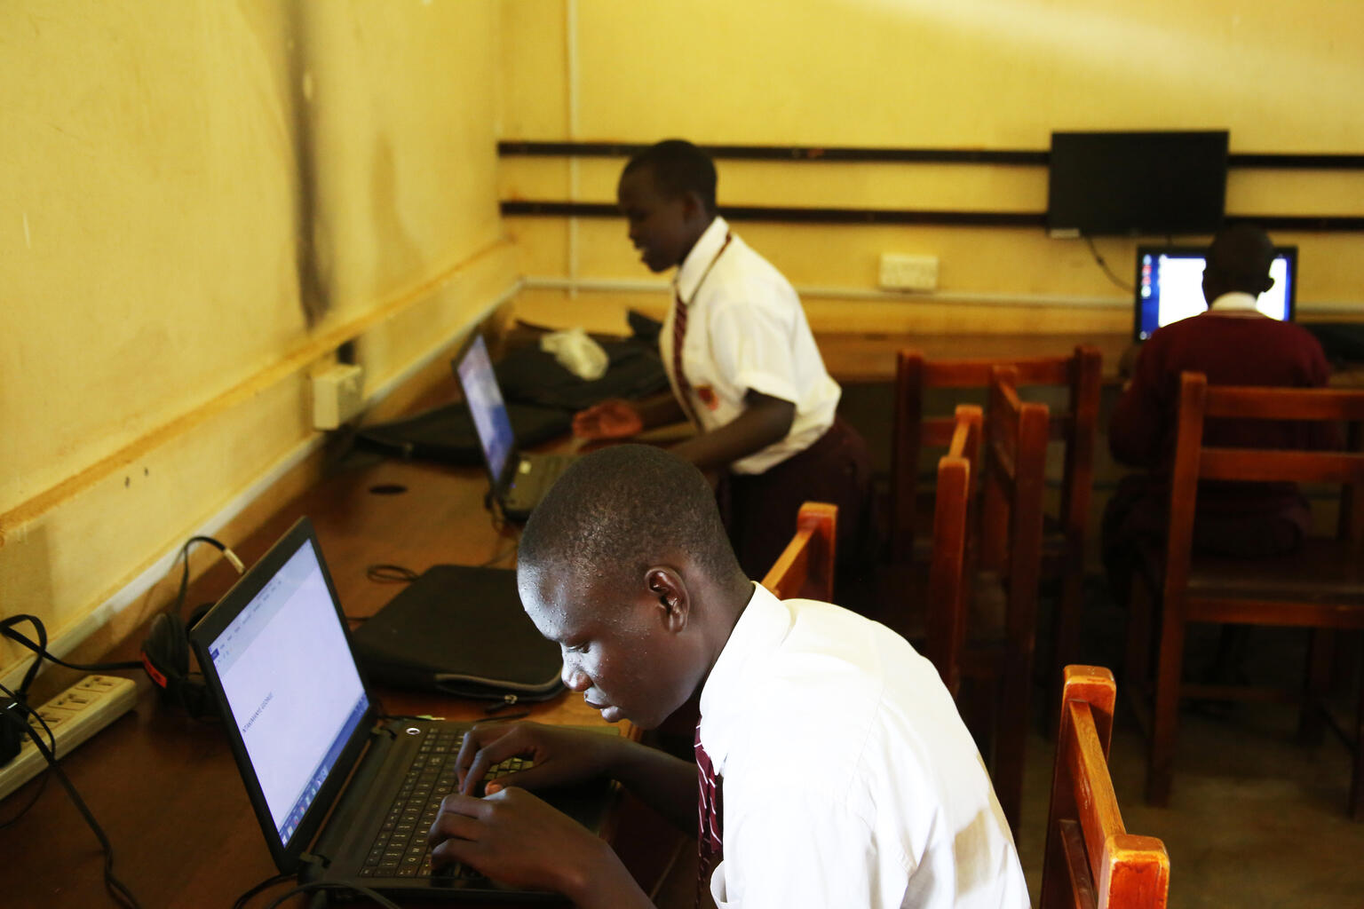
Module 6
Problem solving

Slide 3

2
Unit 2: Identifying needs and technological responses

Slide 4
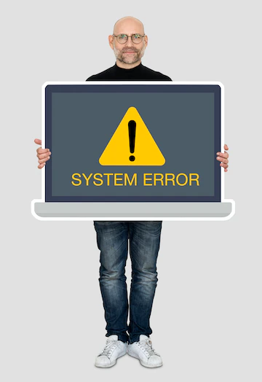
Needs and technological responses
The first step is to find out which component is not working correctly.
Pay attention to the clues that the computer gives us.
Troubleshooting is a process of trial and error. You may need to use several different approaches before you can find a solution.

Slide 5
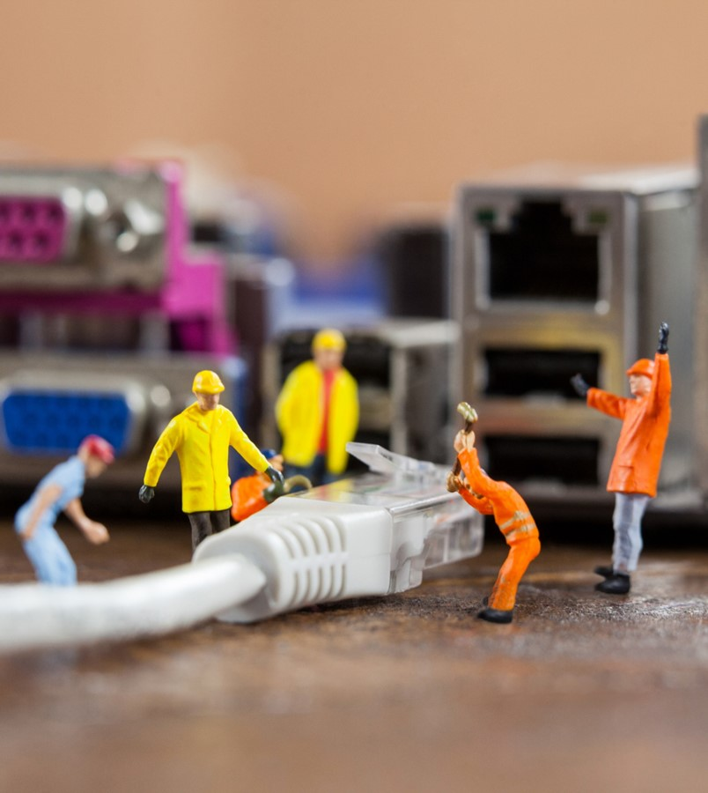
Needs and technological responses
Follow these steps:
Write down your steps.
Take notes about error messages.
Always check the cables.
Restart the computer.
Using the process of elimination.
Use online sources.
Research on the Internet
Online sources

Slide 6
Skills to practise
Use digital tools to solve problems
Scenario: The screen of the laptop that you are using keeps freezing.
Write down the steps you would follow to solve this problem.
Ask for help
Scenario: The screen of the tablet that you are using goes blank and turns blue.
What do you do?

Slide 7
All back covers should include
contact information of the section
producing the work.
© United Nations Children’s Fund (UNICEF) [month and year of publication]

